Slide 1
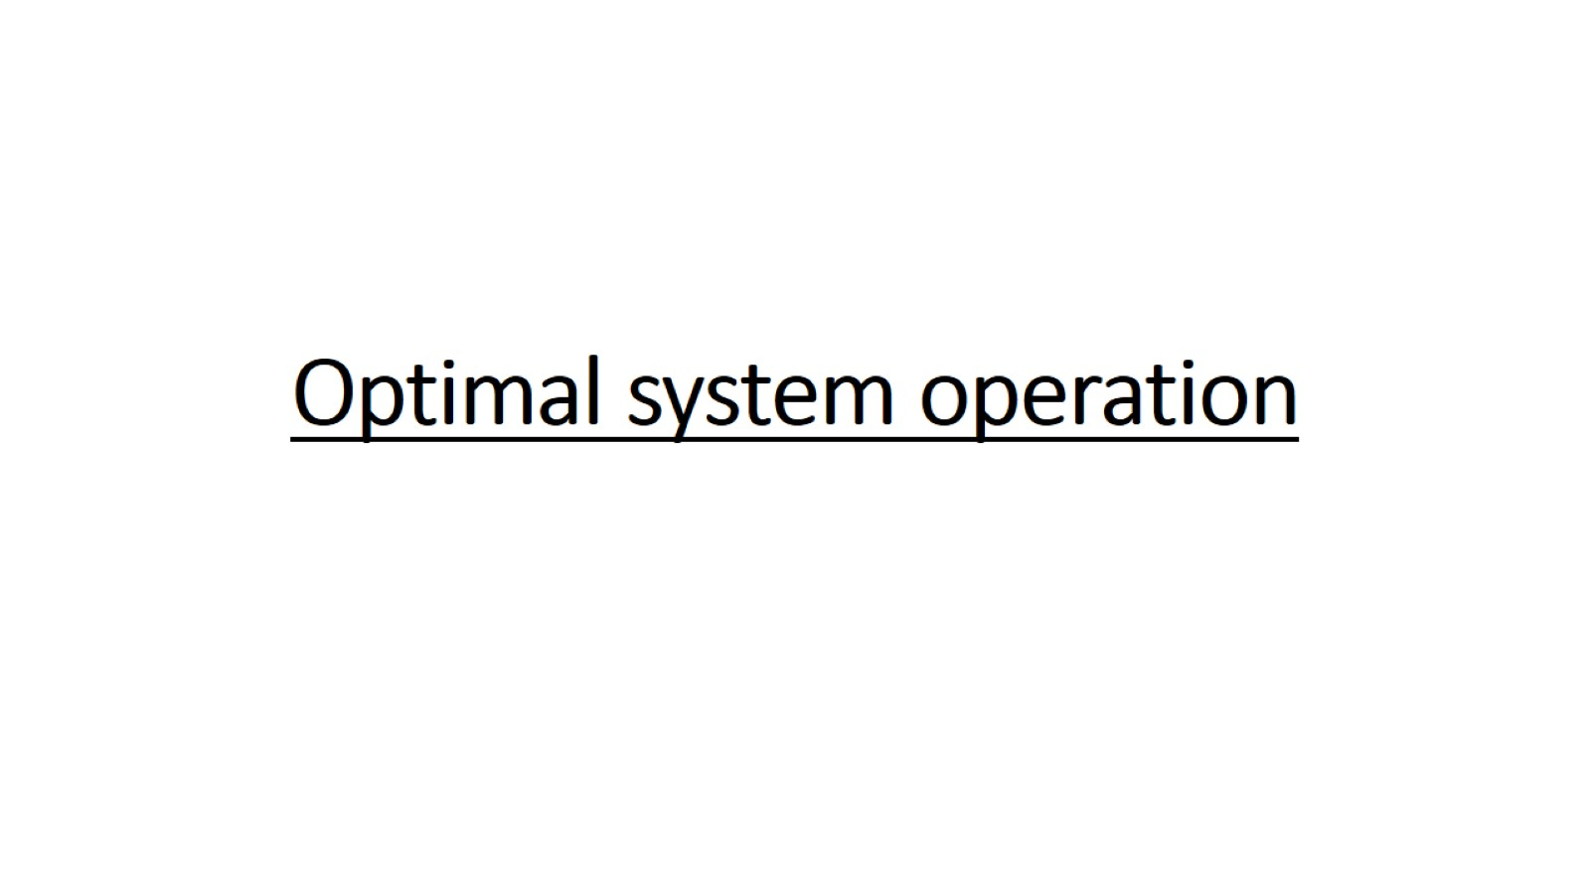
Optimal system operation

Slide 2
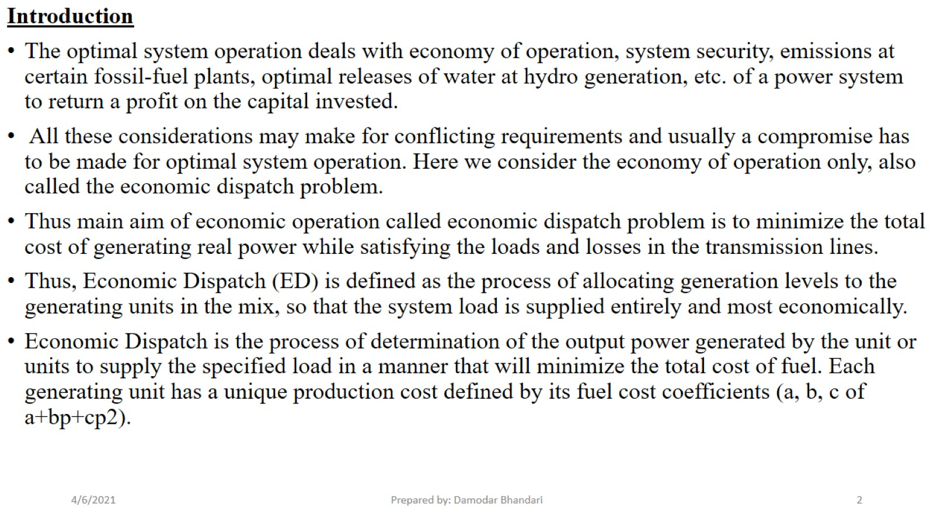

Slide 3
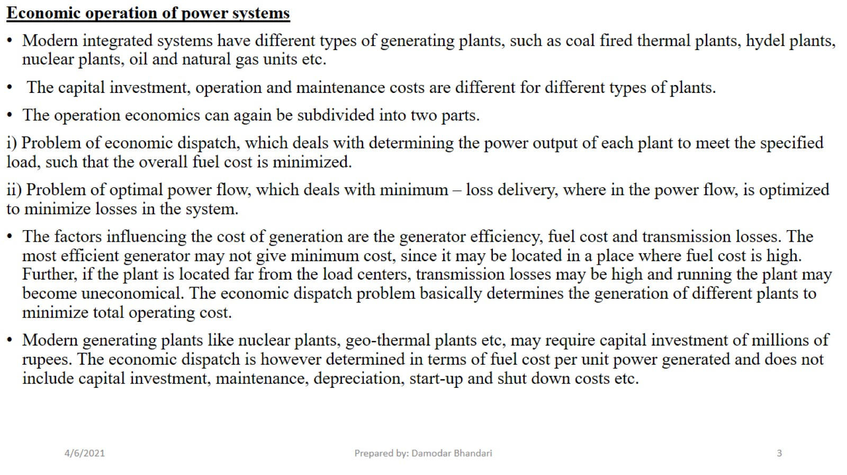

Slide 4
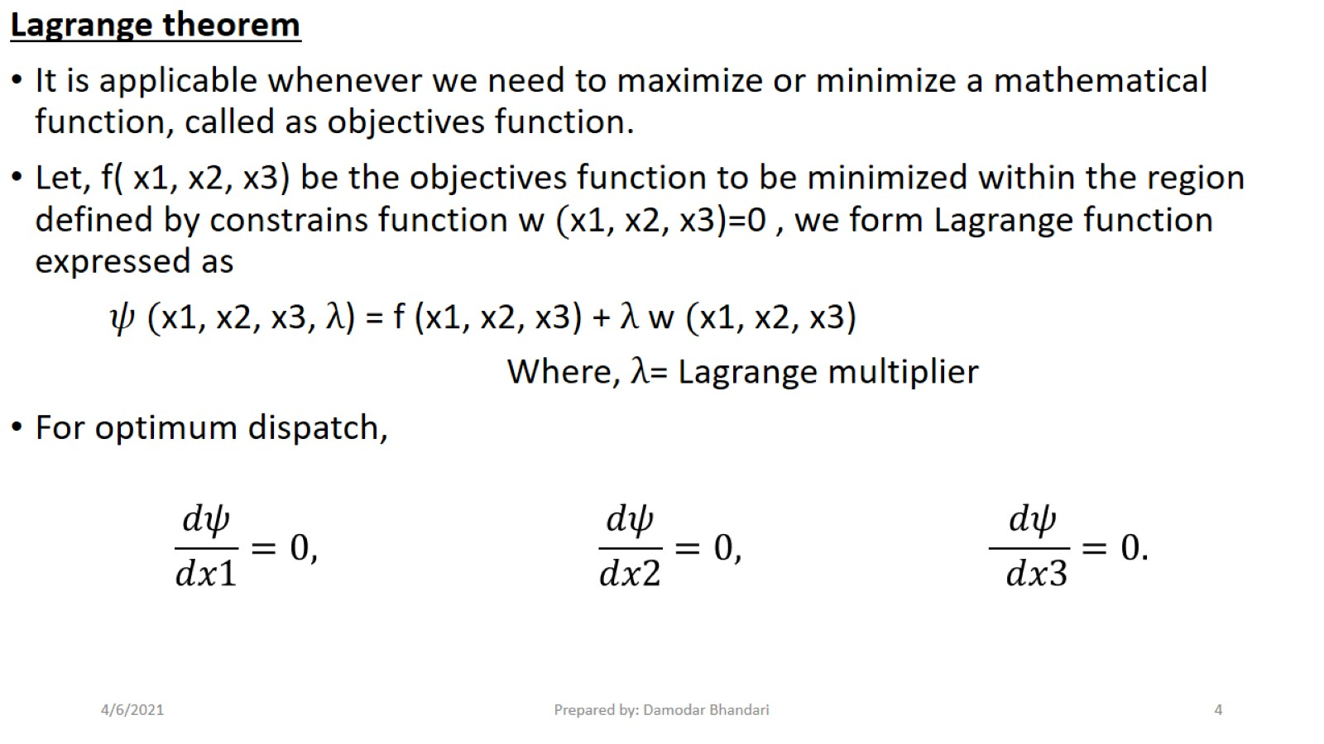

Slide 5
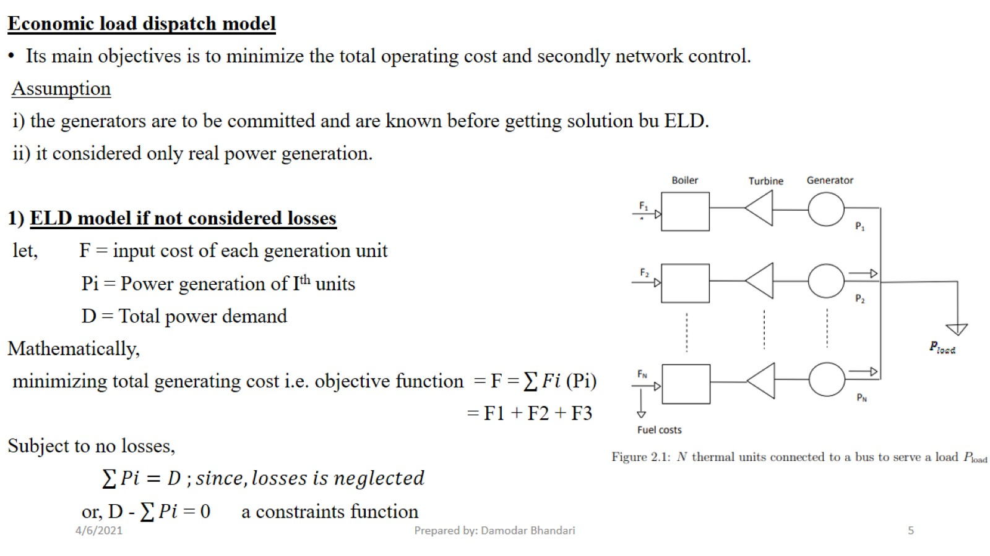

Slide 6
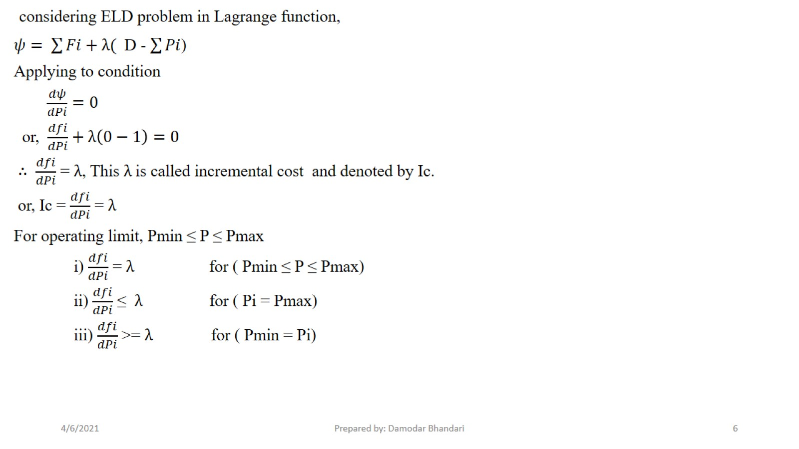

Slide 7
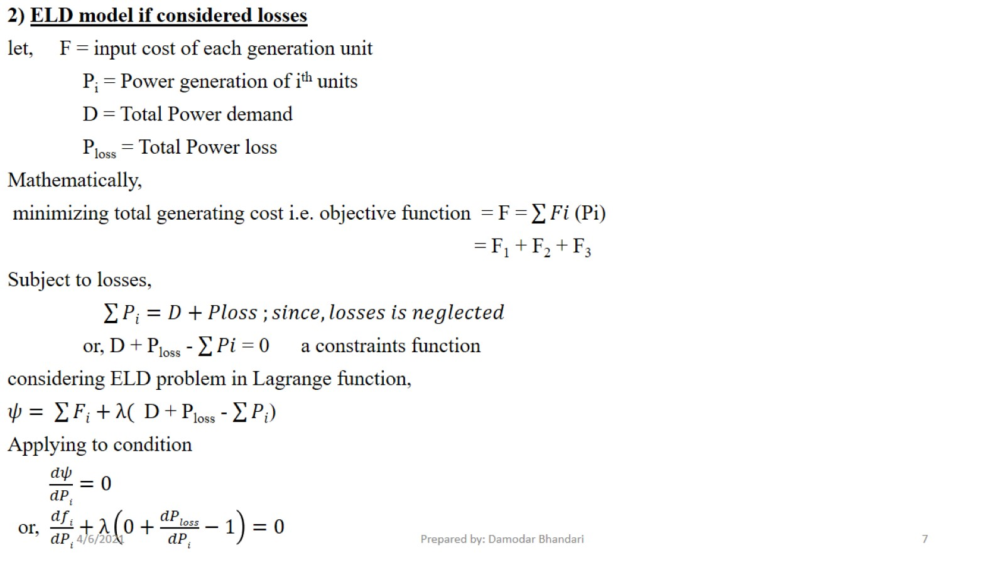

Slide 8
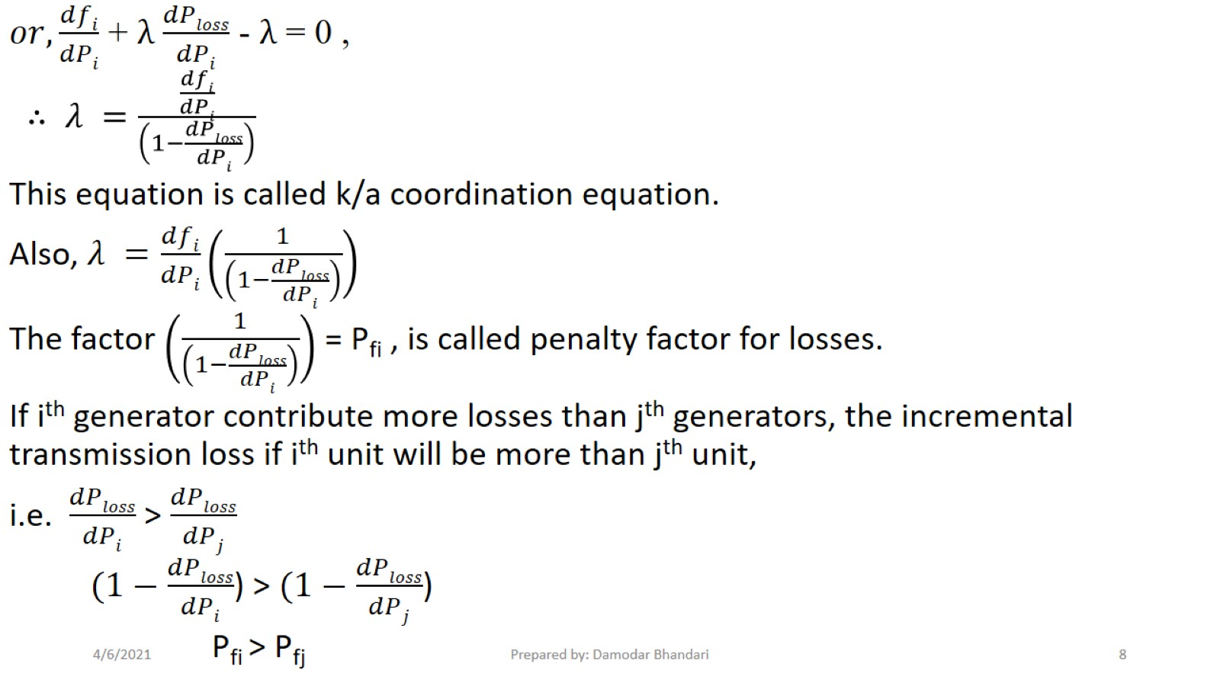

Slide 9
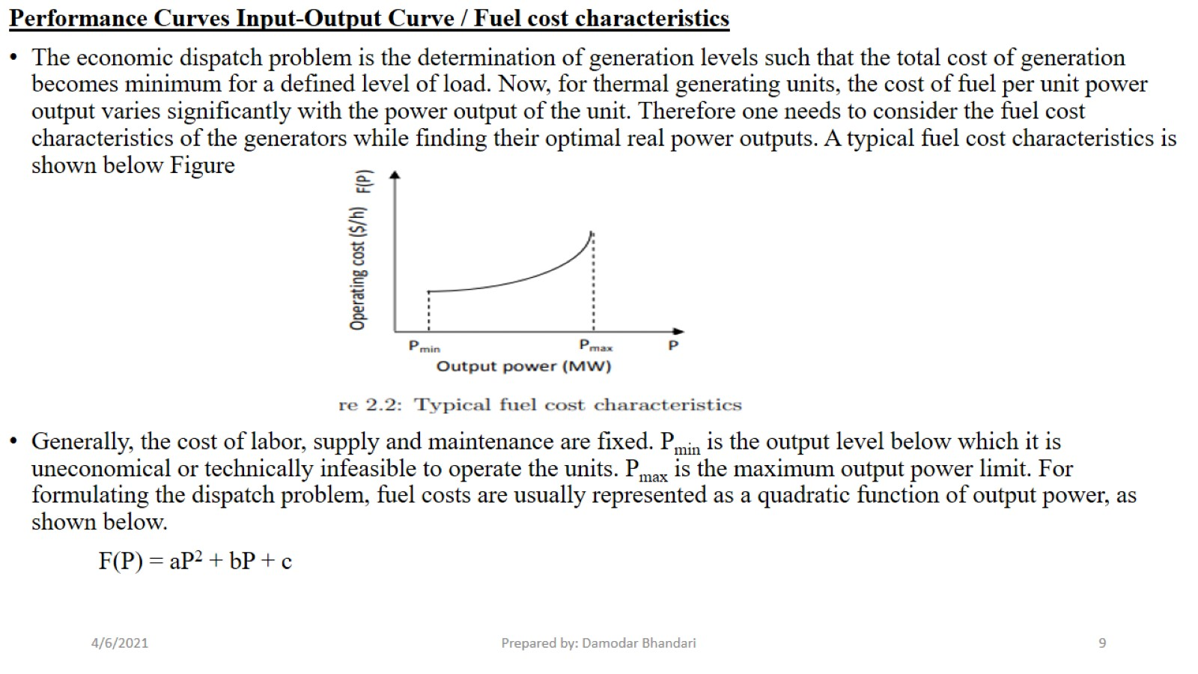

Slide 10
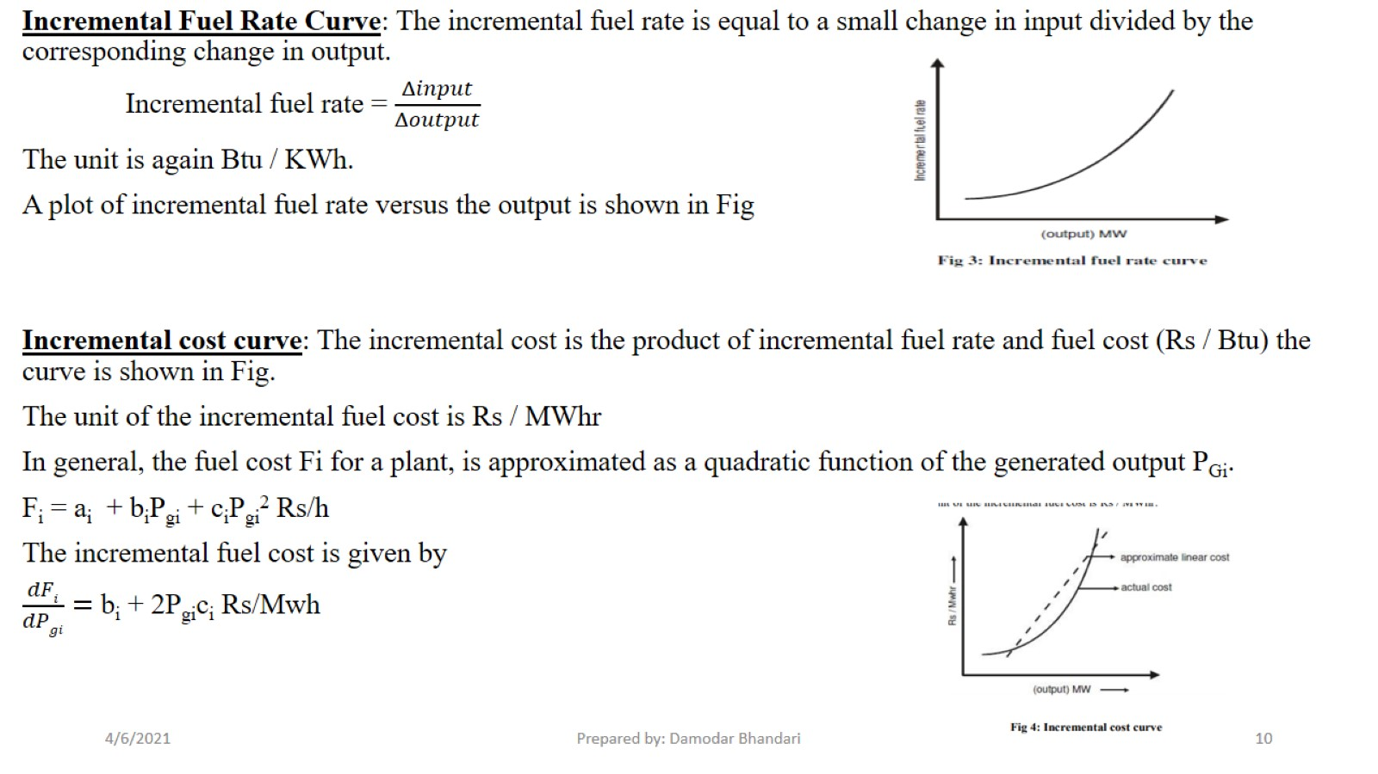

Slide 11
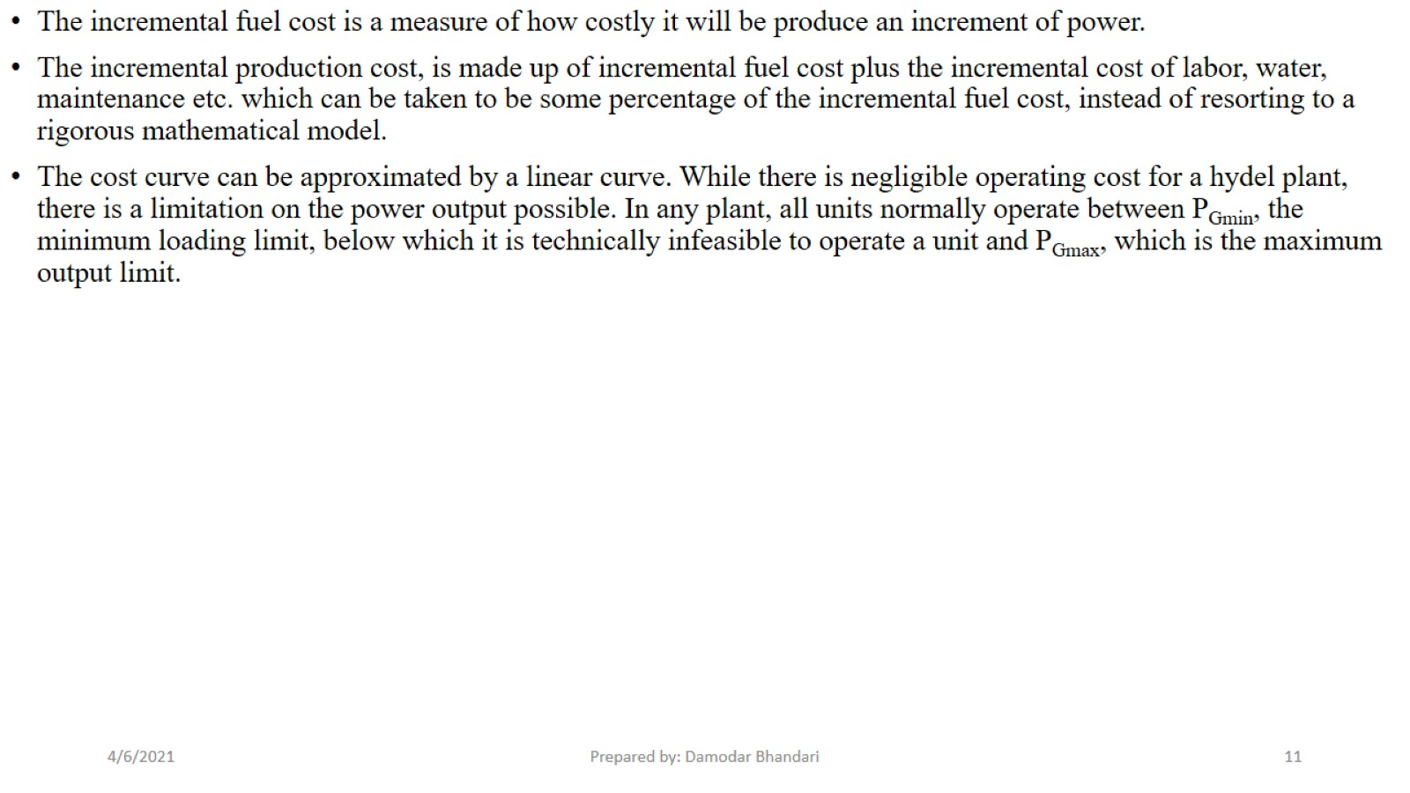

Slide 12
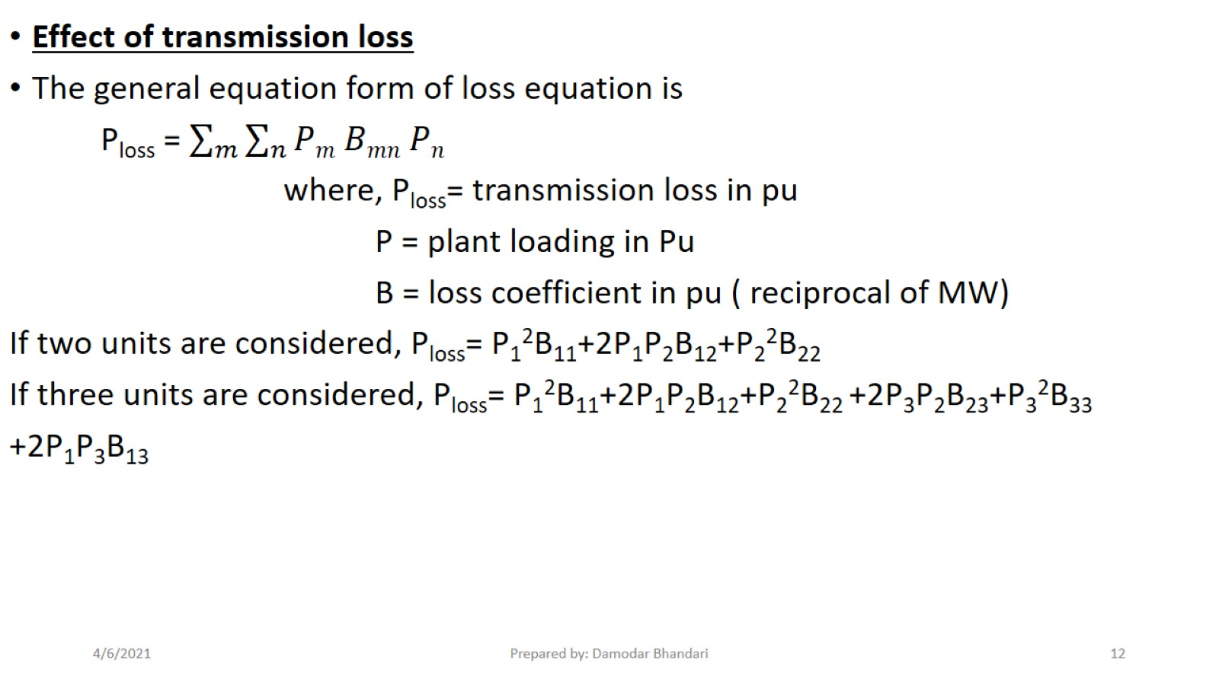

Slide 13
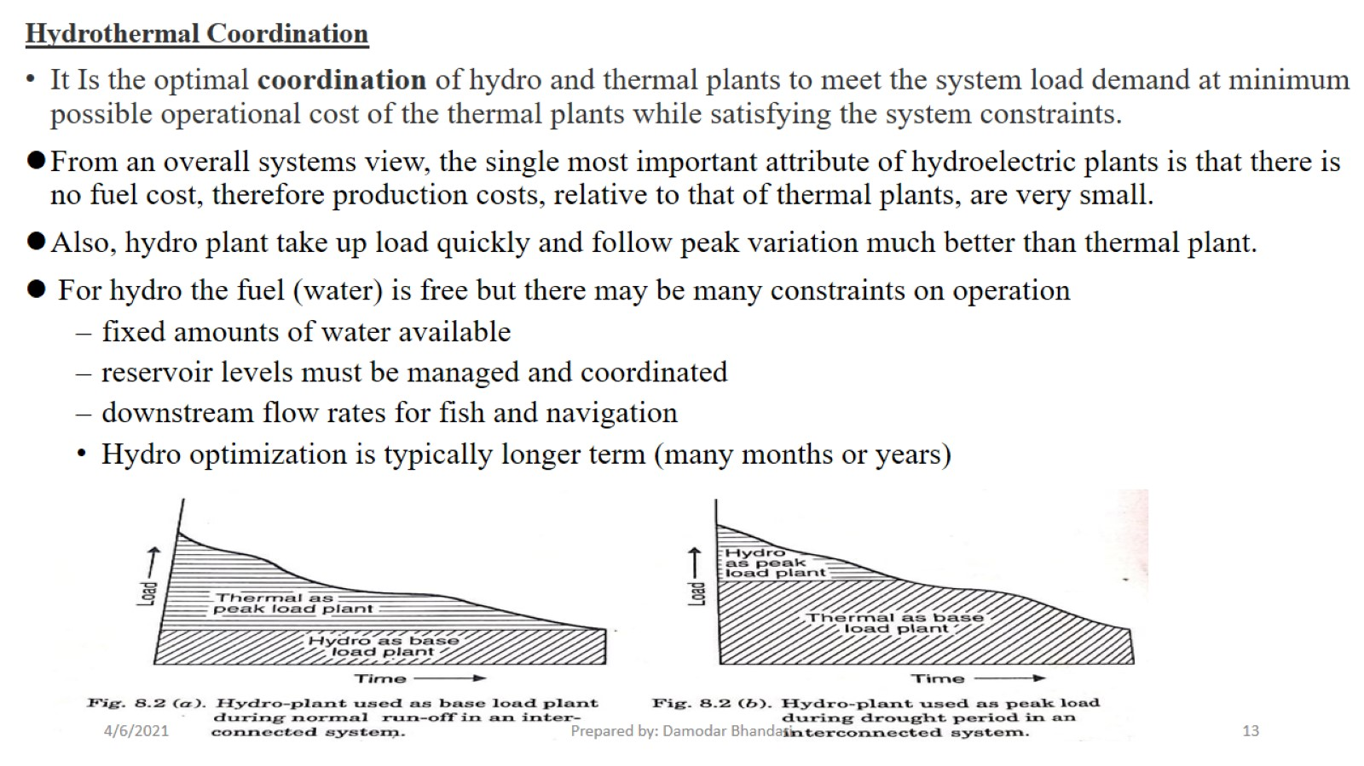

Slide 14
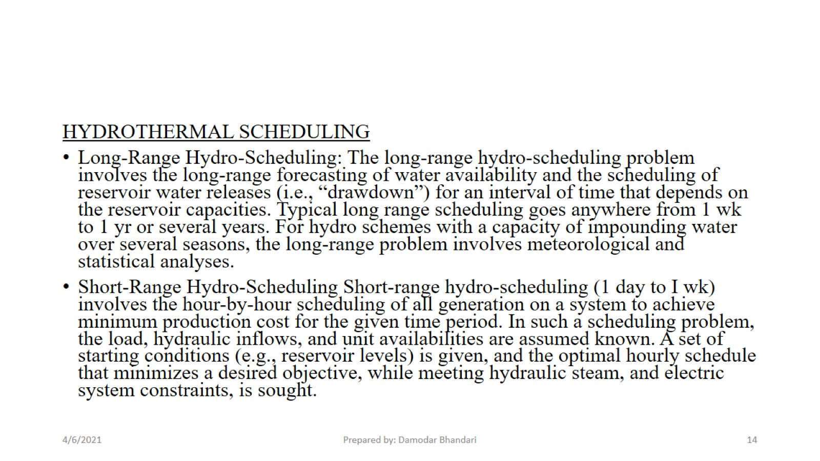

Slide 15
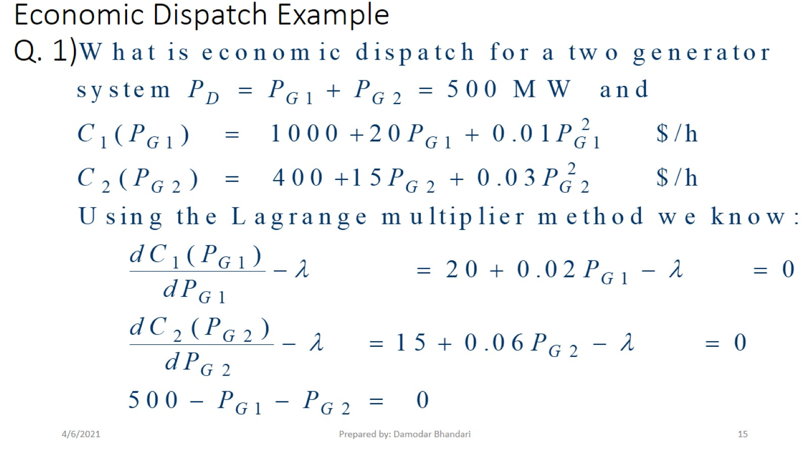
Economic Dispatch Example Q. 1)

Slide 16
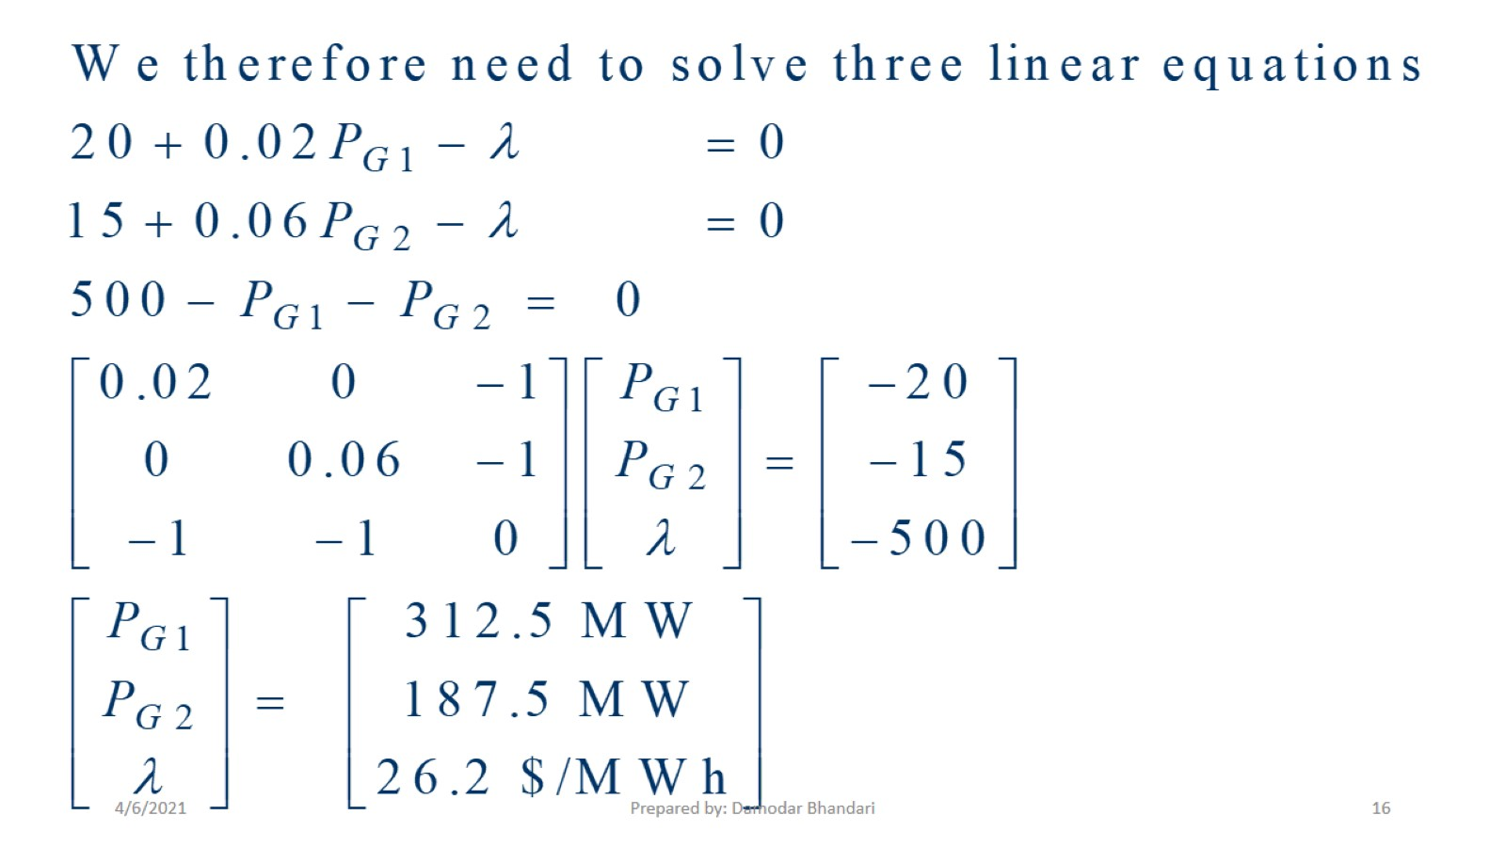

Slide 17
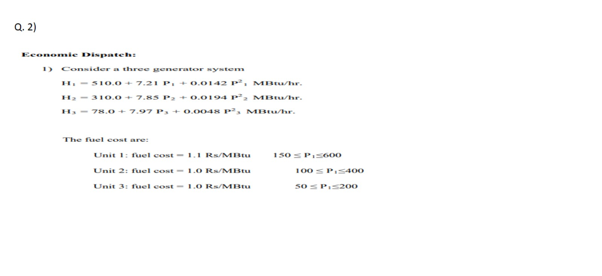

Slide 18
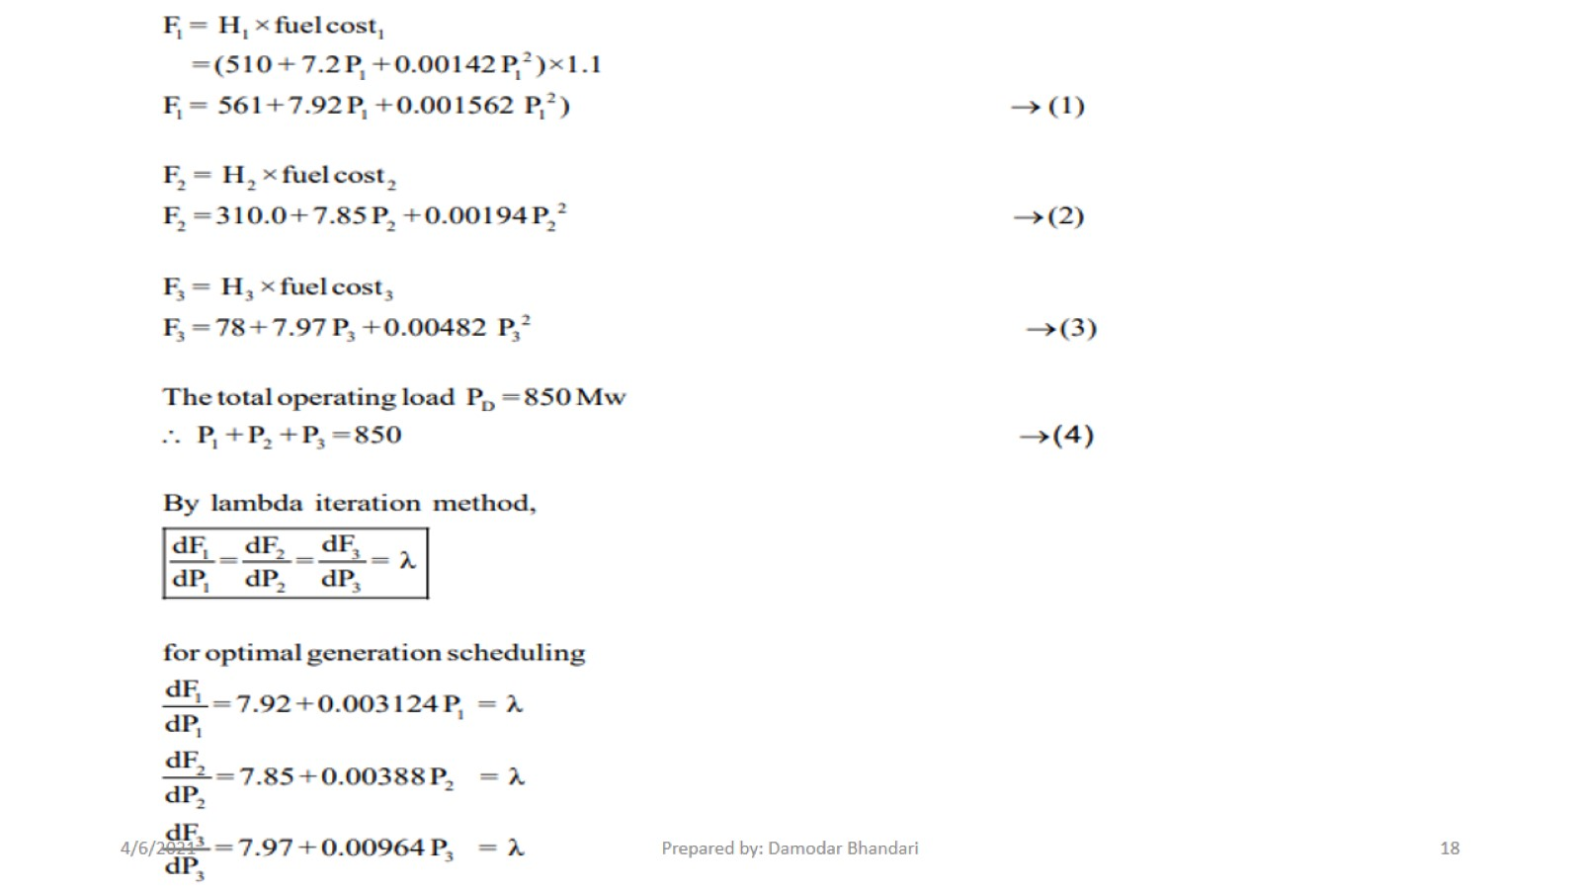

Slide 19
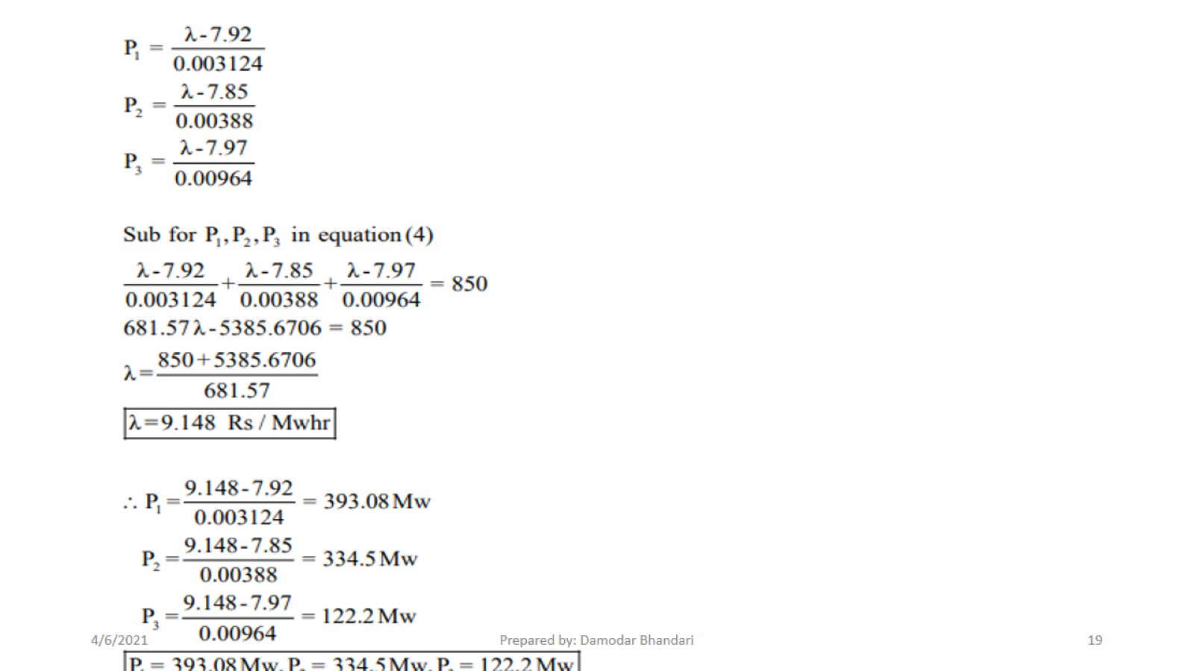

Slide 20
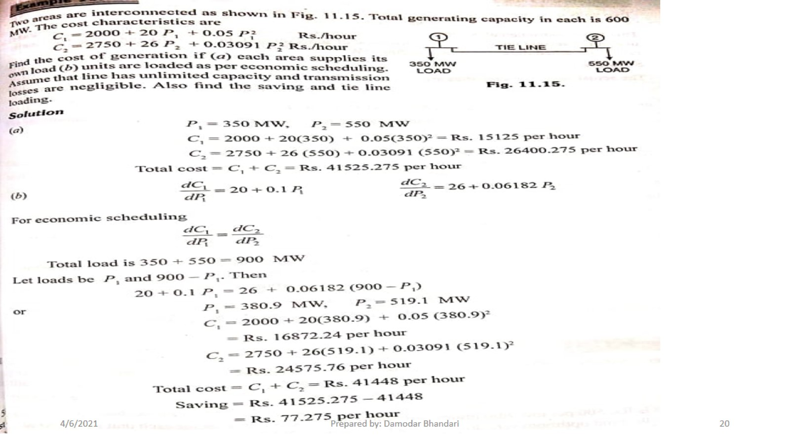

Slide 21
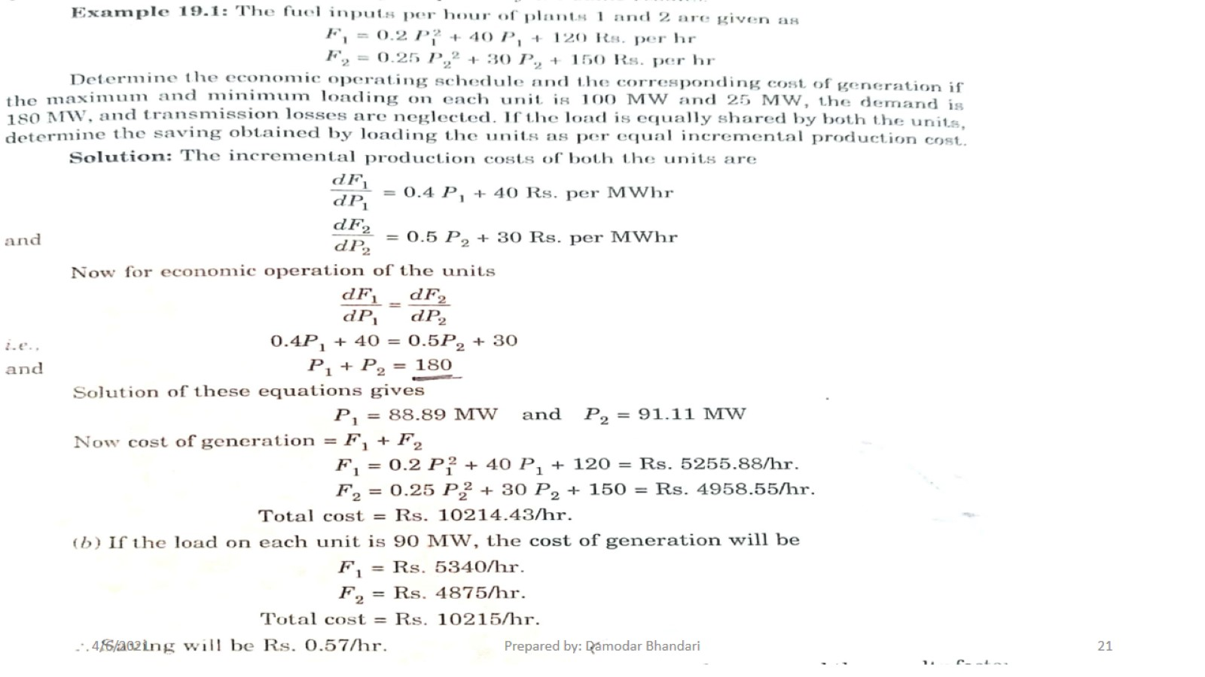

Slide 22
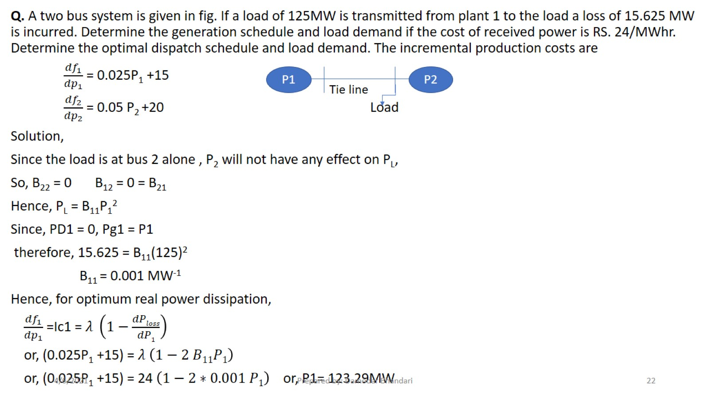

Slide 23
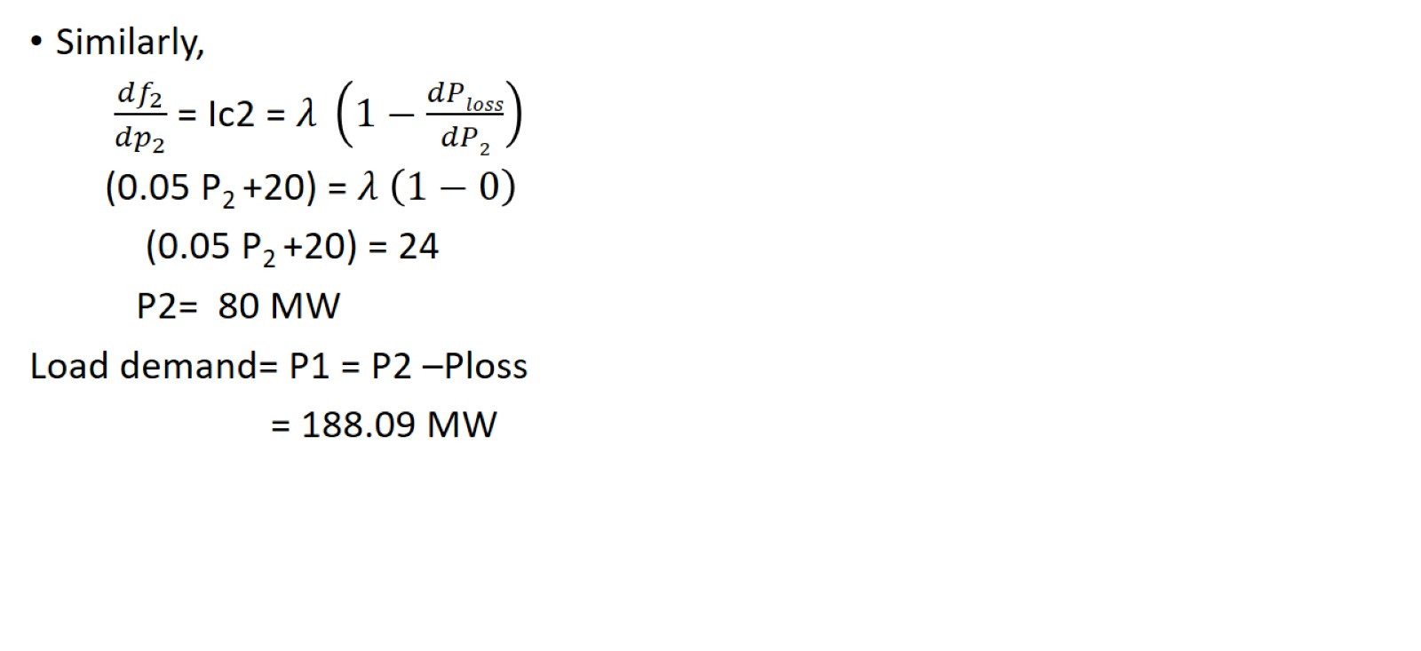

Slide 24
1) A power plant has three units with the following cost characteristics C1= 0.5 P12+ 215 P1 + 5000 Rs/h C2= 1.0 P22+ 270 P2 + 5000 Rs/h C3= 0.7 P32+ 160 P3 + 9000 Rs/h Where Pi are the generating powers in MW. The maximum and minimum loads allowable on each unit are 150 and 39 MW. Find the economic scheduling for a total load of 150 MW. Also find the total operation cost for each case.

